Slide 1
Binary Trees - II
Lecture # 15

Slide 2
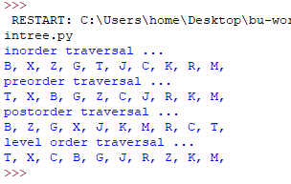
Re-build the tree from traversals
From these traversals, can we rebuild the tree?
The answer is ‘Yes.’

Slide 3
Re-build the tree from traversals
inorder traversal ...
B, X, Z, G, T, J, C, K, R, M,
preorder traversal ...
T, X, B, G, Z, C, J, R, K, M,
From pre-order, we know T is the root.
From in-order, we know T has left child(ren)
From pre-order, we know X is the root of left branch
From in-order, we know X has left child(ren)
From pre-oder, we know B is the root of left branch of X
Because B doesn’t have child, from pre-order, we know G is the root
of the right subtree of X
…

Slide 4
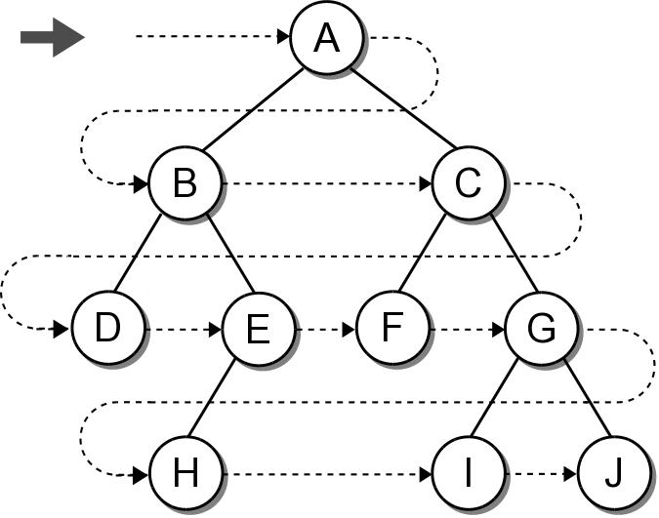
Breadth-First (level order) Traversal
The nodes are visited by level, from left to right.
The previous traversals are all depth-first traversals.

Slide 5
Breadth-First Traversal
Recursion can not be used with this traversal.
We can use a queue and an iterative loop.
def breadth_first_trav( bintree ):
q = Queue()
q.enqueue( bintree )
while not q.is_empty() :
# Remove the next node from the queue and visit it.
node = q.dequeue()
print( node.data )
# Add the two children to the queue.
if node.left is not None :
q.enqueue( node.left )
if node.right is not None :
q.enqueue( node.right )
Try testbintree.py

Slide 6
Array based binary trees
It is very natural to implement binary trees using linked nodes.
For binary tree that has “many” nodes, it may be more effective and efficient to implement it using an array!

Slide 7

Relation among nodes
If the root is at index n, its left child will be at index $2n+1$, its right child will be at index $2n+2$
If a node is at index k, its parent is at index $⌊\frac{k−1}{2}⌋$

Slide 8
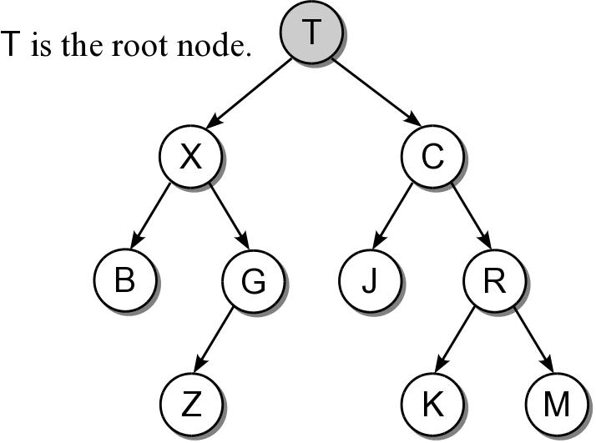
An array-based tree example
T
X
C
B
G
J
R
Z
K
M
0
1
2
3
4
5
6
7
8
9
0
1
2
3
4
5

Slide 9
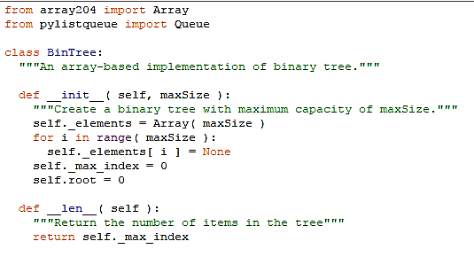
Implementation: constructor

Slide 10
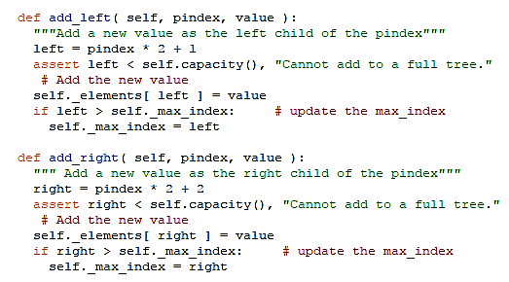
Implementation: adding node

Slide 11
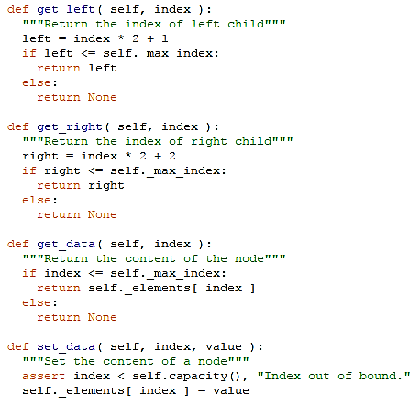
Implementation: accessors

Slide 12
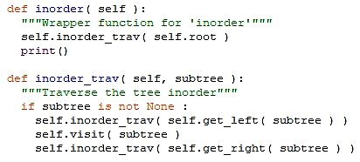
Traversals: in-order

Slide 13
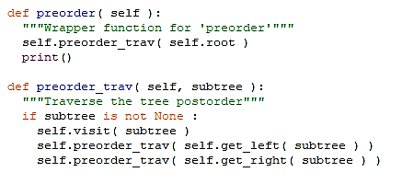
Traversals: pre-order

Slide 14
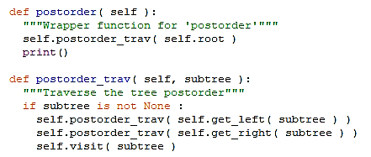
Traversals: post-order

Slide 15
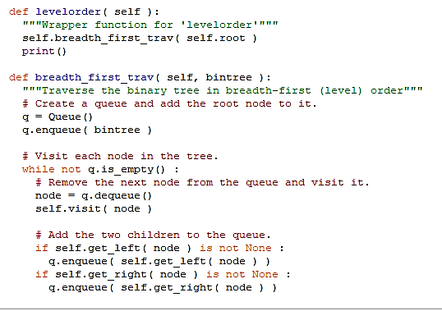
Traversals: level-order

Slide 16
Expression Trees
A binary tree in which the operators are stored in the interior nodes and the operands are stored in the leaves.
Used to evaluate an expression.
Used to convert an infix expression to either prefix or postfix notation.

Slide 17
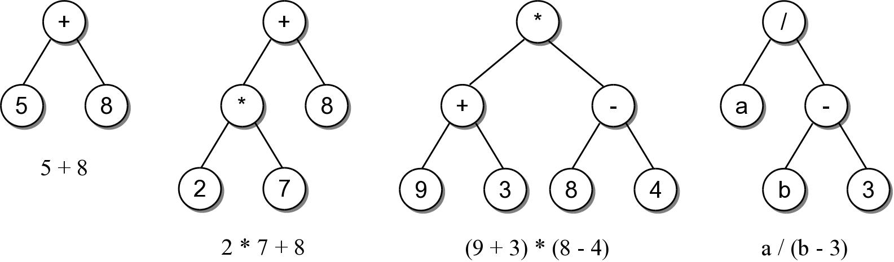
Expression Trees
The tree structure is based on the order in which the operators are evaluated.
Operators in lower-level nodes are evaluated first.
The last operator evaluated is in the root node.

Slide 18
Expression Tree ADT
An expression tree is a binary tree representation of an arithmetic expression.
Contains various operators (+, -, *, /, %)
Contains operands comprised of single integer digits and single-letter variables.
ExpressionTree( exp_str ) evaluate( var_dict ) __str__()

Slide 19
Expression Tree Example
We can use the ADT to evaluate basic arithmetic expressions of any size.
# Create a dictionary containing values for the variables.
vars = { 'a' : 5, 'b' : 12 }
# Build the tree for a sample expression and evaluate it.
exp_tree = ExpressionTree( "(a/(b-3))" )
print( "The result = ", exp_tree.evaluate(vars) )
# We can change the value assigned to a variable
# and reevaluate.
vars['a'] = 22
print( "The result = ", exp_tree.evaluate(vars) )
Try ex1.py

Slide 20
Expression Tree Implementation
exptree.py
class ExpressionTree :
def __init__( self, exp_str ):
self._exp_tree = None
self._build_tree( exp_str ) # recursion
def evaluate( self, var_map ):
return self._eval_tree( self._exp_tree, var_map ) # recursion
def __str__( self ):
return self._build_string( self._exp_tree )
# ...
# Storage class for creating the tree nodes.
class _ExpTreeNode :
def __init__( self, data ):
self.element = data
self.left = None
self.right = None

Slide 21
Expression Tree Evaluation
We can develop an algorithm to evaluate the expression.
Each subtree represents a valid subexpression.
Lower-level subtrees have higher precedence.
For each node, the two subtrees must be evaluated first.
How does it work?

Slide 22
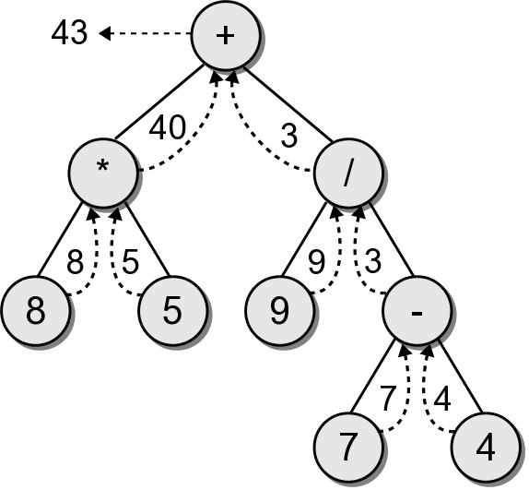
Evaluation Call Tree

Slide 23
Expression Tree Implementation
exptree.py
class ExpressionTree :
# ...
def _eval_tree( self, subtree, var_dict ):
# See if the node is a leaf node
if subtree.left is None and subtree.right is None :
# Is the operand a literal digit?
if subtree.element >= '0' and subtree.element <= '9' :
return int(subtree.element)
else : # Or is it a variable?
assert subtree.element in var_dict, "Invalid variable."
return var_dict[subtree.element]
# Otherwise, it's an operator that needs to be computed.
else :
# Evaluate the expression in the subtrees.
lvalue = _eval_tree( subtree.left, var_dict )
rvalue = _eval_tree( subtree.right, var_dict )
# Evaluate the operator using a helper method.
return compute_op( lvalue, subtree.element, rvalue )

Slide 24
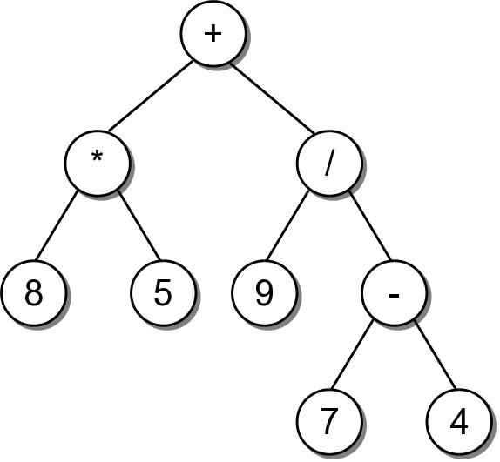
String Representation
To convert an expression tree to a string, we must perform an infix traversal.
8 * 5 + 9 / 7 - 4

Slide 25
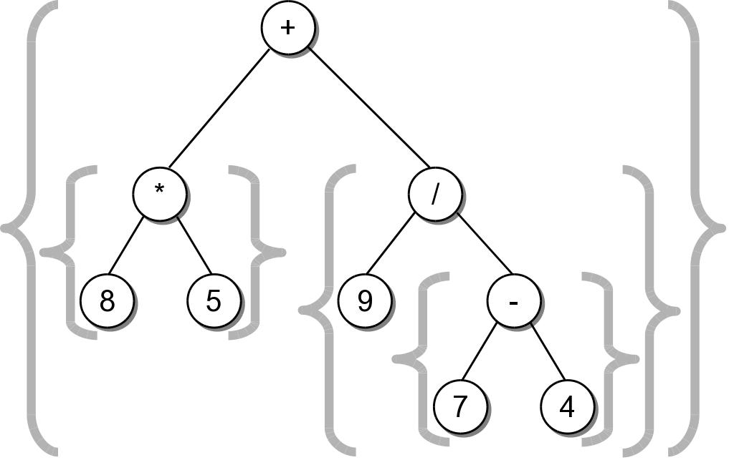
String Representation
The result was not correct because required parentheses were missing.
Can easily create a fully parenthesized expression.
((8 * 5) + (9 / (7 - 4)))
Class activity to implement this __str__() method.

Slide 26
Expression Tree Implementation
exptree.py
class ExpressionTree :
# ...
def _build_string( self, tree_node ):
# If the node is a leaf, it's an operand.
if tree_node.left is None and tree_node.right is None :
return str( tree_node.element )
# Otherwise, it's an operator.
else :
exp_str = '('
exp_str += self._build_string( tree_node.left )
exp_str += str( tree_node.element )
exp_str += self._build_string( tree_node.right )
exp_str += ')'
return exp_str

Slide 27
Expression Tree Construction
An expression tree is constructed by parsing the expression and examining the tokens.
New nodes are inserted as the tokens are examined.
Each set of parentheses will consist of:
an interior node for the operator
two children either single valued or a subexperssion.

Slide 28
Expression Tree Construction
For simplicity, we assume:
the expression is stored in a string with no white space.
the expression is valid and fully parenthesized.
each operand will be a single-digit or single-letter variable.
the operators will consist of +, -, *, /, %

Slide 29
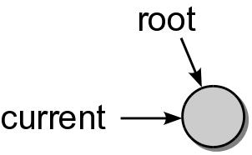
Expression Tree Construction
Consider the expression (8*5)
The process starts with an empty root node set as the current node:
The action at each step depends on the current token.

Slide 30
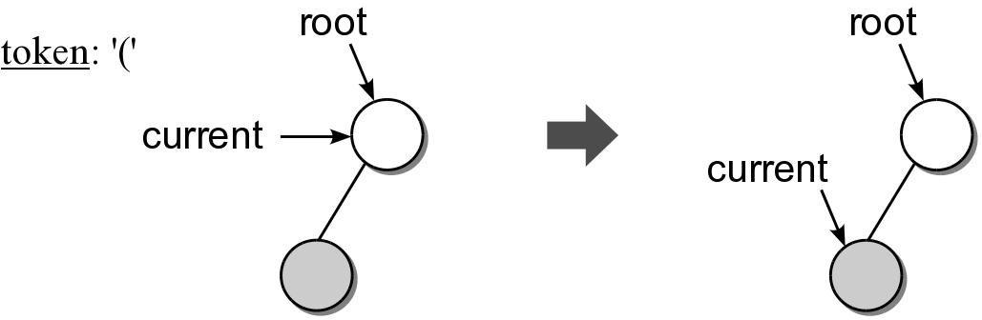
Expression Tree Construction
When a left parenthesis is encountered: (8*5)
a new node is created and linked as the left child of the current node.
descend down to the new node.

Slide 31
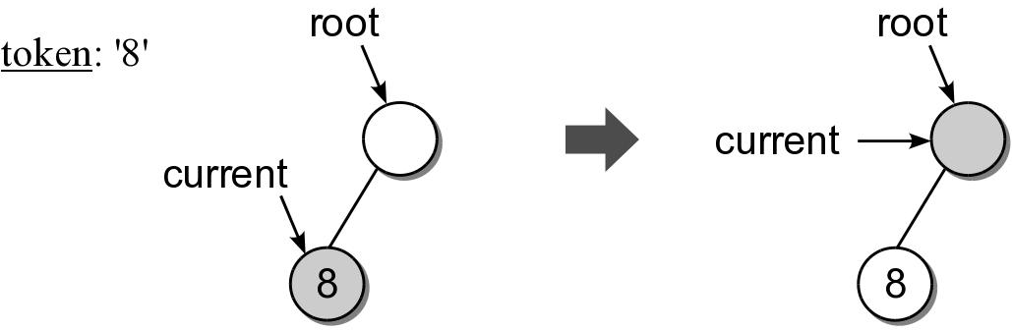
Expression Tree Construction
When an operand is encountered: (8*5)
the data field of the current node is set to contain the operand.
move up to the parent of current node.

Slide 32
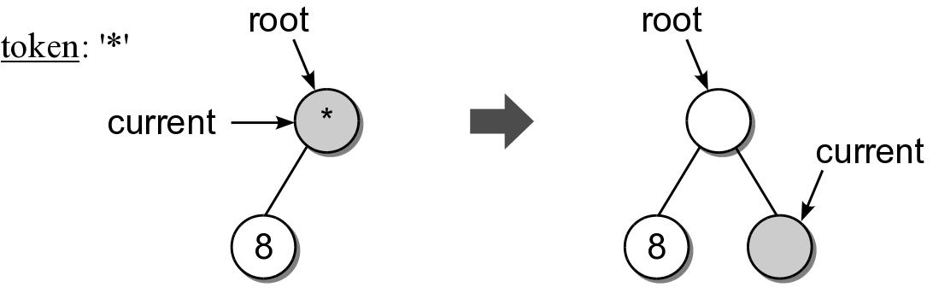
Expression Tree Construction
When an operator is encountered: (8*5)
the data field of the current node is set to the operator.
a new node is created and linked as the right child of the current node.
descend down to the new node.

Slide 33
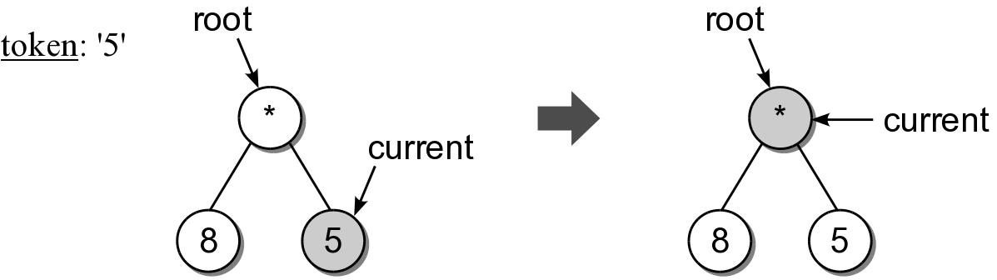
Expression Tree Construction
Another operand is encountered: (8*5)

Slide 34
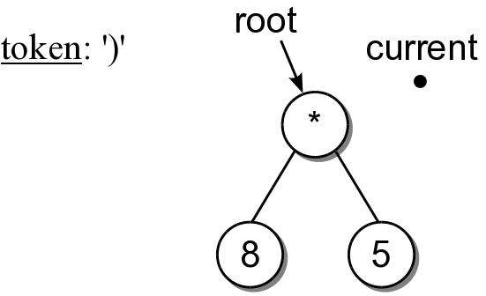
Expression Tree Construction
When a right parenthesis: (8*5)
move up to the parent of the current node.

Slide 35
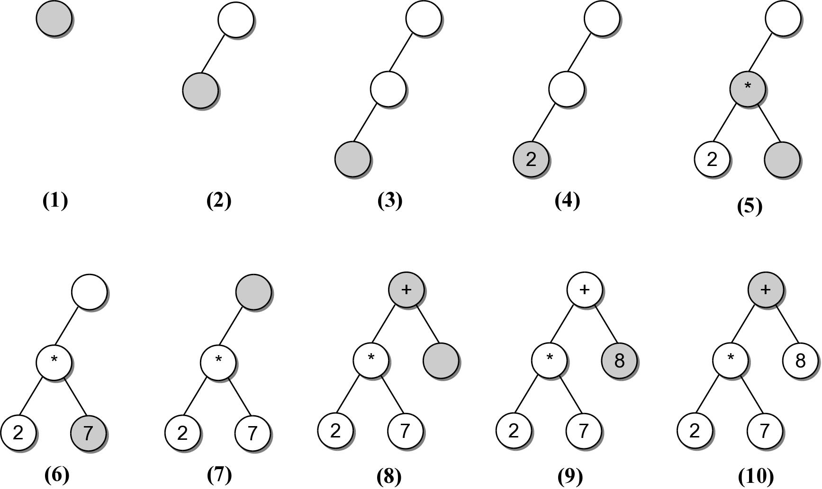
Expression Example #2
((2*7)+8)
Consider another expression:

Slide 36
Expression Tree Implementation
exptree.py
class ExpressionTree :
# ...
def _build_tree( self, exp_str ):
# Build a queue containing the tokens from the expression.
expQ = Queue()
for token in exp_str :
expQ.enqueue( token )
# Create an empty root node.
self._exp_tree = _ExpTreeNode( None )
# Call the recursive function to build the tree.
self._rec_build_tree( self._exp_tree, expQ )

Slide 37
Expression Tree Implementation
exptree.py
class ExpressionTree :
# ...
def _rec_build_tree( self, cur_node, expQ ):
# Extract the next token from the queue.
token = expQ.dequeue()
# See if the token is a left paren: '('
if token == '(' :
cur_node.left = _ExpTreeNode( None )
build_treeRec( cur_node.left, expQ )
# The next token will be an operator: + - / * %
cur_node.data = expQ.dequeue()
cur_node.right = _ExpTreeNode( None )
self._build_tree_rec( cur_node.right, expQ )
# The next token will be a ), remove it.
expQ.dequeue()
# Otherwise, the token is a digit.
else :
cur_node.element = token

Slide 38



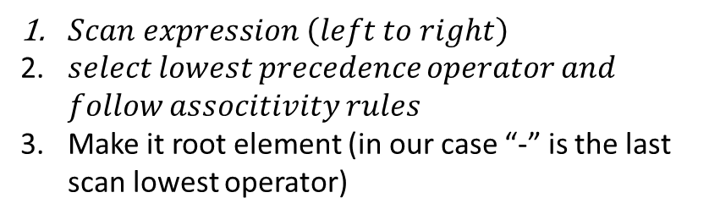




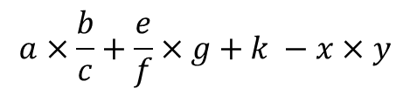





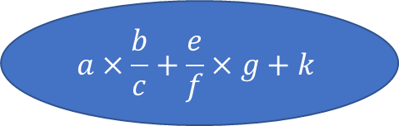


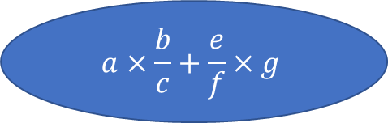

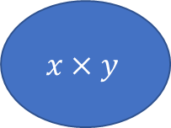

Binary expression Tree construction
-
$$a×\frac{b}{c}+\frac{e}{f}×g+k$$
$$x×y$$
$$a×\frac{b}{c}+\frac{e}{f}×g+k −x×y$$
Interior nodes = operators
Leaves = operands
+
$$×$$
$$a×\frac{b}{c}+\frac{e}{f}×g$$
$Scan expression \left(left to right\right)$
𝑠𝑒𝑙𝑒𝑐𝑡 𝑙𝑜𝑤𝑒𝑠𝑡 𝑝𝑟𝑒𝑐𝑒𝑑𝑒𝑛𝑐𝑒 𝑜𝑝𝑒𝑟𝑎𝑡𝑜𝑟 𝑎𝑛𝑑 𝑓𝑜𝑙𝑙𝑜𝑤 𝑎𝑠𝑠𝑜𝑐𝑖𝑡𝑖𝑣𝑖𝑡𝑦 𝑟𝑢𝑙𝑒𝑠
Make it root element (in our case “-” is the last scan lowest operator)
$$k$$
$$x$$
$$y$$
+
$$a×\frac{b}{c}$$
$$\frac{e}{f}×g$$
Precedence | Operator | Associativity
1 | ^ | R→L
2 | X, / | L→R
3 | +,- | L→R
/
$$×$$
$$a×b$$
$$c$$
$$\frac{e}{f}$$
$$g$$
$$×$$
\
$$a$$
$$b$$
$$e$$
$$f$$

Slide 39









Binary expression Tree construction
-
-
$$a×\frac{b}{c}+\frac{e}{f}×g+k$$
$$x×y$$
+
*
+
$$k$$
$$y$$
+
$$×$$
$$x$$
$$a×\frac{b}{c}+\frac{e}{f}×g$$
$$k$$
$$x$$
$$y$$
/
*
*
$$c$$
/
$$g$$
+
$$a×\frac{b}{c}$$
$$\frac{e}{f}×g$$
$$a$$
$$b$$
$$e$$
$$f$$
/
$$×$$
$$a×b$$
$$c$$
$$\frac{e}{f}$$
$$g$$
$$×$$
\
$$a$$
$$b$$
$$e$$
$$f$$

